Slide 1
EE439 Discussions How do Uncertainty Impact Economic Activity?
Kantapong (ID: 6004640030)
Faculty of Economics, Thammasat University, Bangkok, Thailand

Slide 2

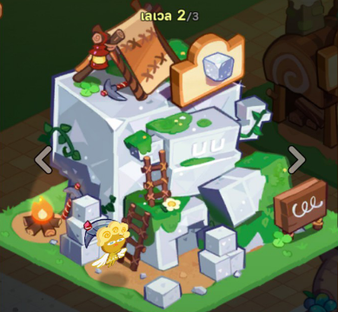
Reactions!
Writing a Paper (Last week)
Listening to my talk! (today)

Slide 3






When Cookies Saw My Slides Last Night, …
Writing a Paper (Last week)
Listening to my talk! (today)

Slide 4


How do Uncertainty Impact Economic Activity?
Economic Uncertainty Before and After Covid-19
Goal: Look at uncertainty measures before and after Covid-19
Impact of Policy Uncertainty on Economy
Goal: Survey methodology used for estimating the impact
Economic Policy Uncertainty (EPU) Index
Goal: Construct a toy example on EPU

Slide 5

Measures Used to Characterize Uncertainty
1. VIX: forward-looking volatility using options on S&P500
2. Newspaper-Based (EPU): reflect uncertainty perceived by journalists
3. Business-Expectation Surveys: subjective opinions on sales growth
4. Forecaster Disagreement: use disagreement in surveys
5. Time-Series Model: GARCH Model

Slide 6
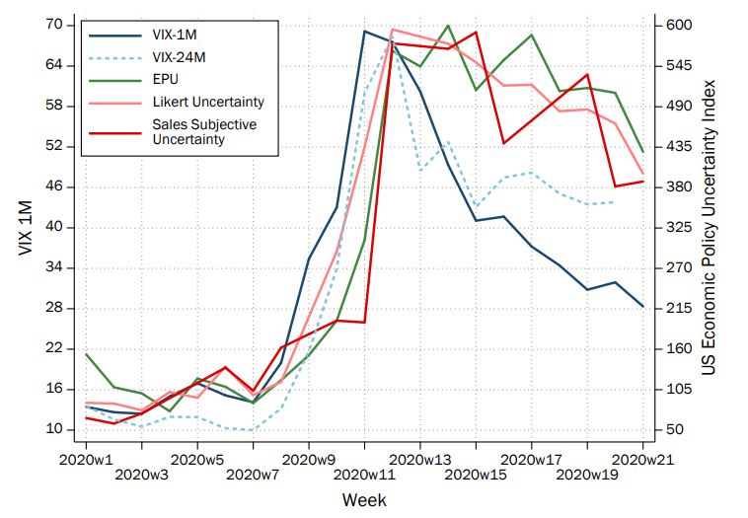

Uncertainty Spiked!
Source: Altig, D., Baker, S., Barrero, J.M., Bloom, N., Bunn, P., Chen, S., Davis, S.J., Leather, J., Meyer, B., Mihaylov, E. and Mizen, P., 2020. Economic uncertainty before and during the COVID-19 pandemic. Journal of Public Economics, 191, p.104274.

Slide 7
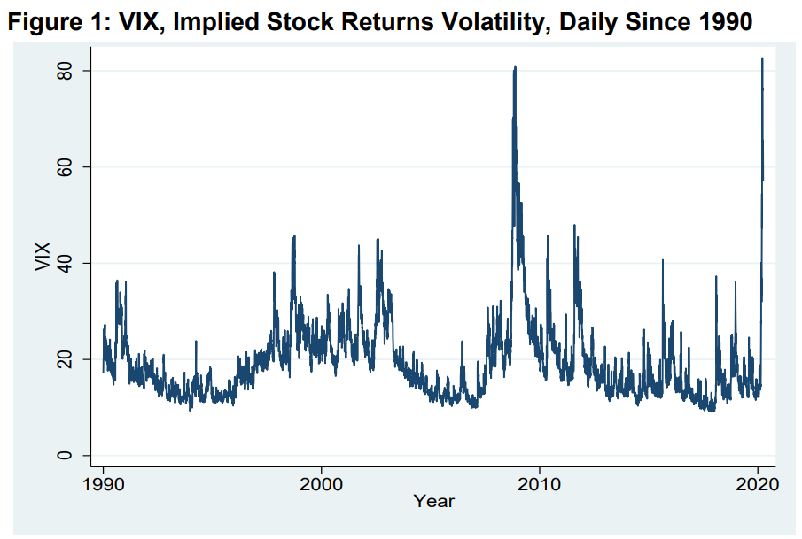

VIX Spiked in 2020
Source: Baker, S.R., Bloom, N., Davis, S.J. and Terry, S.J., 2020. Covid-induced economic uncertainty (No. w26983). National Bureau of Economic Research.

Slide 8
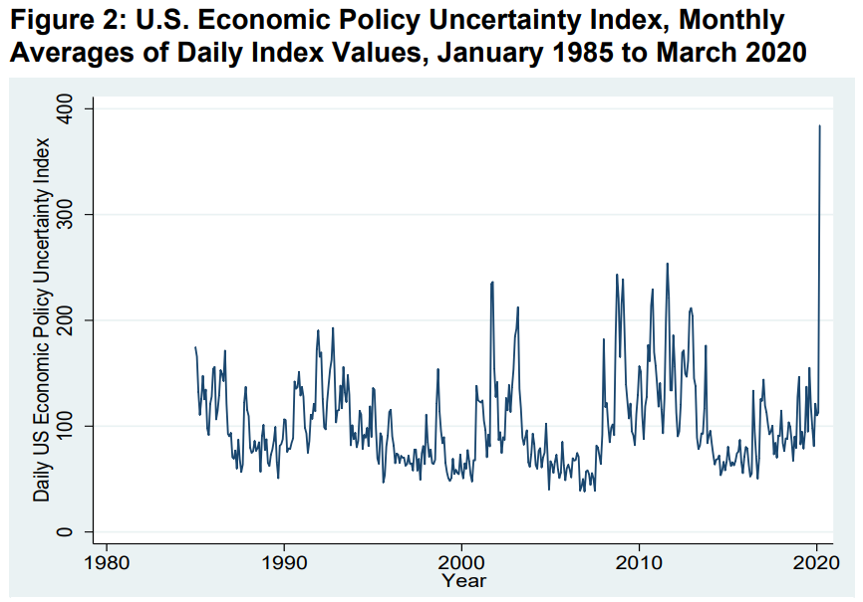
EPU Spiked in 2020
Source: Baker, S.R., Bloom, N., Davis, S.J. and Terry, S.J., 2020. Covid-induced economic uncertainty (No. w26983). National Bureau of Economic Research.

Slide 9
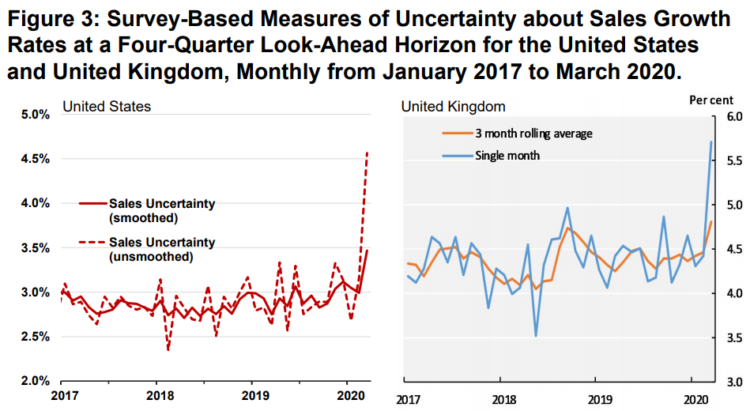
Survey-Based Measures Spiked in 2020
Source: Baker, S.R., Bloom, N., Davis, S.J. and Terry, S.J., 2020. Covid-induced economic uncertainty (No. w26983). National Bureau of Economic Research.

Slide 10
Effects of Policy Uncertainty on Economy
The main question is how policy uncertainty affects economic outcomes.
Two approaches used by Baker, Bloom and Davis (2016):
1. Use firm-level data to capture government purchases
Results: Policy uncertainty affects stock price uncertainty
2. Use macro-level data to capture multiple channels
Results: Policy uncertainty affects macro-variables such as
industrial production, employment growth.

Slide 11
Firm-Level Data
Dependent Variable: option-implied stock price volatility
Main independent variables: EPU index
Other control variables: VIX, Federal purchase per GDP, Exposure to Government purchases
Approach: Panel-data method, controlling for entity-fixed effect and time-fixed effect

Slide 12
Models
+
-
1) Vol = f(log(EPU); Fed Purchase/GDP)
2) Vol = f(log(EPU)*intensity; (Fed Purchase/GDP)*intensity; i, t)
3) Vol = f(log(EPU); log(VIX); Fed Purchase/GDP)
4) Vol = f(log(EPU)*intensity; log(VIX)*intensity; (Fed Purchase/GDP)*intensity; i, t)
+
-
-
+
-
+
-
-
Baker, S.R., Bloom, N. and Davis, S.J., 2016. Measuring economic policy uncertainty. The quarterly journal of economics, 131(4), pp.1593-1636.

Slide 13
Macro-Level Data
Approach: Use VAR with Cholesky decomposition
Variables: EPU index, log(S&P500), federal funds rate, log employment, log industrial production (each for 3 lags)
Visualization: Impulse response function of industrial production and employment to 90-point EPU innovation

Slide 14
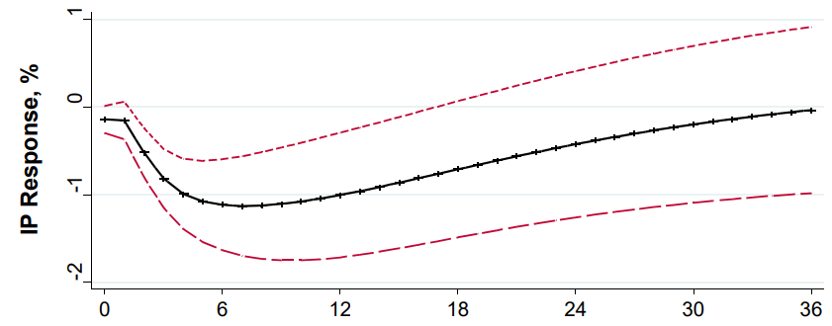


IP Response to 90-point EPU Shocks
Baker, S.R., Bloom, N. and Davis, S.J., 2016. Measuring economic policy uncertainty. The quarterly journal of economics, 131(4), pp.1593-1636.

Slide 15
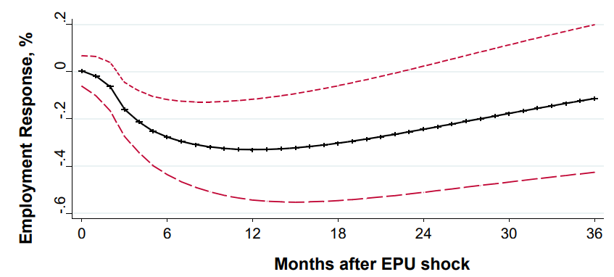
Employment Response to 90-point EPU Shocks
Baker, S.R., Bloom, N. and Davis, S.J., 2016. Measuring economic policy uncertainty. The quarterly journal of economics, 131(4), pp.1593-1636.

Slide 16
Economic Policy Uncertainty Index
Data Source: Newspaper Articles
Process: Count the number of articles related to economic policies
Index: Scale the raw count by the number of newspaper articles
Ref: https://www.policyuncertainty.com/

Slide 17
EPU Index -> E-P-U
Three buckets of words contain E-P-U buckets.
U buckets = (uncertainty, uncertain),
E buckets = (economic, economy)
P buckets = (congress, deficit, Federal Reserve, legislation)
Note that the P words are selected by audit and pilot study.

Slide 18
Training Process
Audit study: get labels from human
Pilot study: refine the training process
Selecting P term set: obtain classification report
(false positive & false negative)

Slide 19


False Positive & False Negative
This is NOT cookie!
This is a cookie!

Slide 20
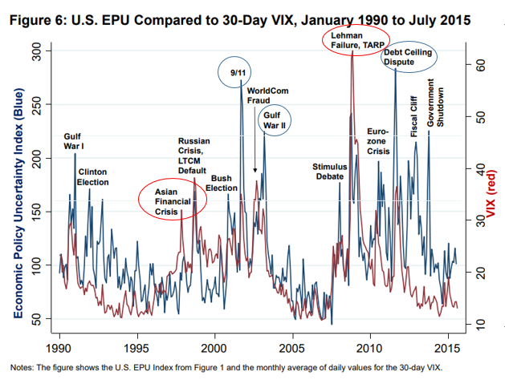
Evaluation: EPU vs VIX
EPU: Policy-focused, no explicit horizon
VIX: Stock-focused, 30-day horizon

Slide 21

Activities
Motivation: There is no EPU index for Thailand, so let’s try making one.
Data Source: Internet Articles
Buckets: Think about what words should represent Thailand, land of smile!
(USA) Three buckets of words contain E-P-U buckets.
U buckets = (uncertainty, uncertain),
E buckets = (economic, economy)
P buckets = (congress, deficit, Federal Reserve, legislation)

Slide 22
References
- Altig, D., Baker, S., Barrero, J.M., Bloom, N., Bunn, P., Chen, S., Davis, S.J., Leather, J., Meyer, B., Mihaylov, E. and Mizen, P., 2020. Economic uncertainty before and during the COVID-19 pandemic. Journal of Public Economics, 191, p.104274.
- Baker, S.R., Bloom, N., Davis, S.J. and Terry, S.J., 2020. Covid-induced economic uncertainty (No. w26983). National Bureau of Economic Research.
- Baker, S.R., Bloom, N. and Davis, S.J., 2016. Measuring economic policy uncertainty. The quarterly journal of economics, 131(4), pp.1593-1636.

Slide 23
Follow me!
Discussion Materials:
https://github.com/GoodDee/EE439_Discussion

Slide 24

See you Again!
CONGRATULATIONS!

